Slide 1



Hide & Seek with Spectres
Efficient discovery of speculative information leaks with random testing
Oleksii Oleksenko,
Boris Köpf
Marco Guarnieri
Mark Silberstein
Notes:
Hi. Thanks for the introduction
I’m …
And today I’m presenting our paper titled “Hide and Seek with Spectres”

Slide 2








This Talk is About CPU Testing
Testing Target
Off-the-shelf
black-box CPUs
Goal
  Find
  previously-unknown speculative leaks
  Our Contribution
  Techniques to detect
  leaks 10x-50x faster
Notes:
My talk today is about testing black-box CPUs
The goal of our testing would be to find information leaks that are caused by speculative execution and that we do not yet know about
Now technically speaking, there are already tools could achieve this goal, but the problem is that they are quite inefficient
In this talk, I will present techniques for making those tools orders of magnitude faster.

Slide 3

Example: Speculative Leak
Input:
secret = 256
Program:
if secret < 50:
x = *secret
Data Cache
0
1
2
3
4
5
6
7
Notes:
For starters, what exactly do I mean when I say a “speculative leak”?
It’s a situation when a co-located attacker can extract a program’s data by observing its microarchitectural traces, and these traces are caused by speculative execution
The example here contains a leak caused by branch misprediction, which would be an instance of Spectre V1
Our goal would be to automatically find other CPU optimizations that could cause leaks like this

Slide 4
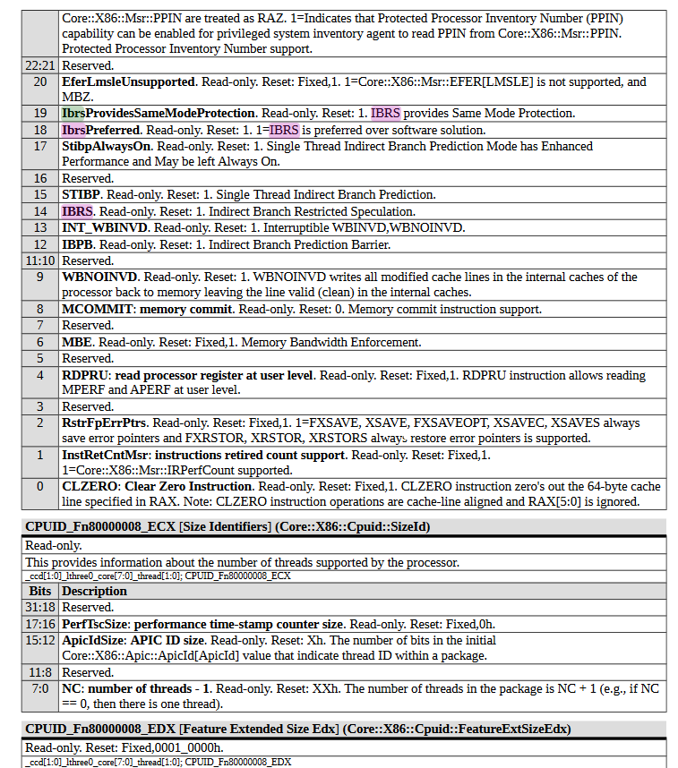
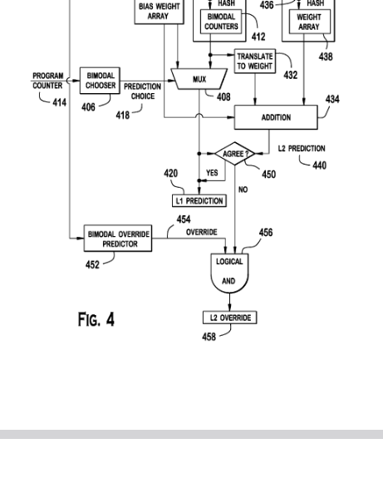
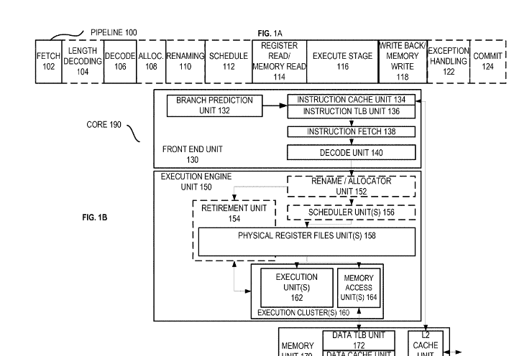
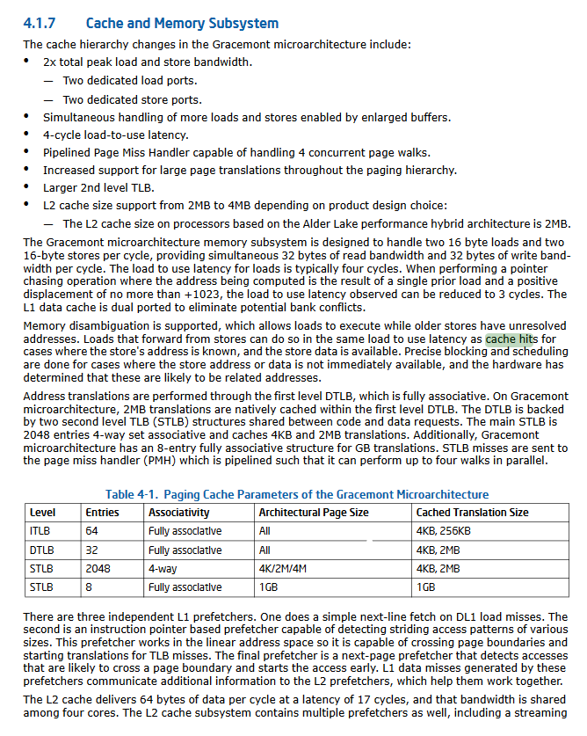
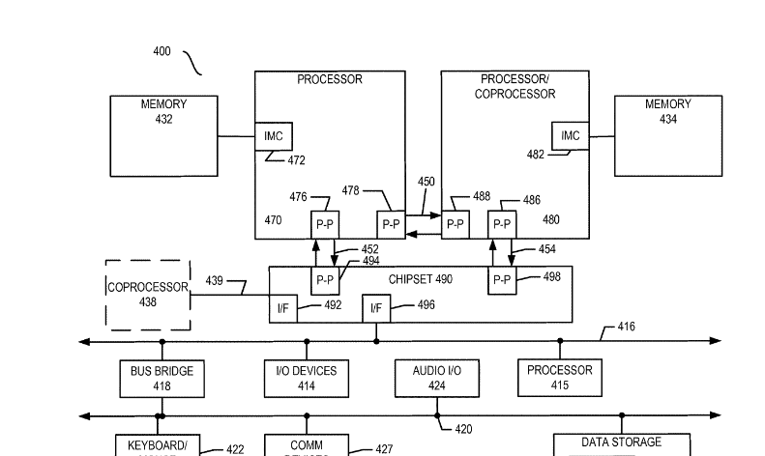
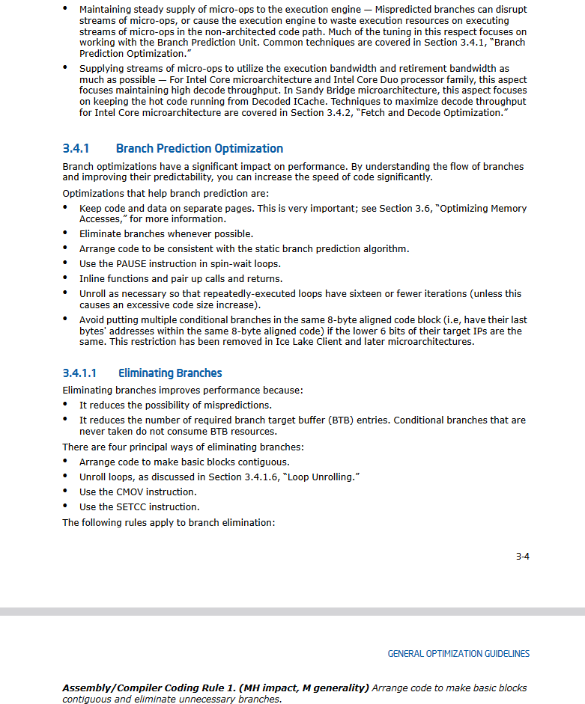
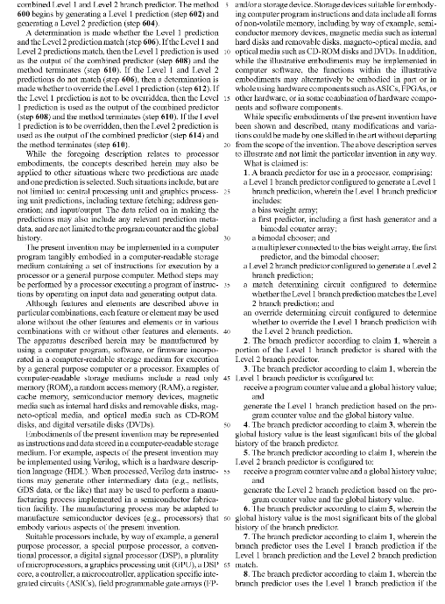
How to Find Speculative Leaks
Manual Analysis
Read docs, manuals, papers
Run experiments
Repeat
Problem:
The method is
slow and ad-hoc
Notes:
Now how do we approach this problem?
Most of the known speculative leaks have been discovered manually, including Spectre, Meltdown
To find them, researchers: read vendors’ manuals, optimization guides, patents; make a hypothesis based on this info; and try to prove it by running experiments.
This approach, however, is not sustainable long-term as it heavily relies on public information, and it’s extremely hard to find leaks caused by hidden optimizations this way

Slide 5





Model-based Leakage Testing
Test Case Generation
Collection of
Hardware Observations
Model-based Filtering
011100
100101
010001
100010
011100
100101
010001
100010
011100
100101
010001
100010
Problem:
This is a slow and wasteful process
Notes:
Fortunately, there is an automated solution
There has been recent proposals to automate this process via random testing
The idea is probe the CPU randomly
Tools like this: generate small random programs; execute them on the target CPU; record the information exposed while executing the test case, thus capturing both known and unknow leaks; compare the recorded measurements against the model of known leaks, and discard instances of known leaks; which leaves us the new stuff.
This approach is already better as it does not rely on any vendor’s information and it’s automated
Yet it has a flaw of its own – it is slow
Most of the test cases produced are not revealing anything new
Hence it takes a long time to detect a leak

Slide 6

This Paper
Test Case Generation
Model-based
Input
Generation
Collection of
Hardware Observations
Model-based Filtering
Pre-filtering
011100
100101
010001
100010
011100
100101
010001
100010
011100
100101
010001
100010
011100
100101
010001
100010
011100
100101
010001
100010
011100
100101
010001
100010
011100
100101
010001
100010
011100
100101
010001
100010
Enhance Effective Test Cases
Discard Ineffective Test Cases
Notes:
In this paper, we target this inefficiency by adding two more stages
The first new stage checks if the test case shows signs of speculative leakage, and discards the cases that don’t
The second stage enhances the test case to make detection more likely

Slide 7
This Paper
Test Case Generation
Model-based
Input
Generation
Collection of
Hardware Observations
Model-based Filtering
Pre-filtering
011100
100101
010001
100010
011100
100101
010001
100010
011100
100101
010001
100010
011100
100101
010001
100010
011100
100101
010001
100010
011100
100101
010001
100010
011100
100101
010001
100010
011100
100101
010001
100010
Notes:
skip

Slide 8
Idea 1: Speculation Filter
Goal:
  discard test cases without speculation
  Approach:
  execute test case on CPU
  detect speculation with perf. counters
Example of Discarded
Test Case
Program:
x = secret + 123
y = x * x
z = *x
No speculation
Notes:
The filtering process begins from checking if the test case shows signs of speculation.
For this, we execute the test case on the CPU, and monitor it’s performance counters. If we see no speculation, we discard the test case

Slide 9
Idea 2: Observation Filter
Goal:
  discard test cases that leave no speculative traces
  Approach:
  add speculation barriers to test case
  collect hardware observations
  compare observations with original
Example
Original:
x = *secret
if x < 50:
z = *secret
"Fenced" Version:
x = *secret
LFENCE
if x < 50:
LFENCE
z = *secret
Evicted
Cache Line #N
Evicted
Cache Line #N
No difference -> discard
Notes:
Next, we check the test case for unique speculative leakage.
In the example, here the program on the left speculates and it exposes some data speculatively, but the data has been already exposed non-speculatively. It makes this test case useless.
We check for such situations by doing a little experiment: We execute the program on the target CPU; measure it’s traces’; then we modify the test case by adding a speculation barrier after every instruction; and we check if the traces change. If they don’t, it’s a useless test case and we discard it.

Slide 10
Idea 3: Model-based Input Generation
Goal:
  enhance test case with model-equivalent inputs
  Approach:
  use taint analysis to produce inputs with identical model observations
Example
Enhanced Test Case
Original Test Case
Leakage Model
with Tainting
Input 1:
x = 100; y = 20
Input 1:
x = 100; y = 20
x is tainted
Input 2:
x = 100; y = 43
Program:
a = *x
if x < 50:
b = *y
Program:
a = *x
if x < 50:
b = *y
Notes:
Finally, when we have a useful test case, we try to improve it
Here I need to explain a bit of background: Our test cases constitute of a program and a sequence of inputs to it. This program is checked for non-interference w.r.t. the model of known leaks. To do it, each input has to be paired with another input that produces the same trace according to the model. Now the chances of producing such inputs randomly are slim, which makes most of the randomly-generated inputs useless.
We fix it by creating such input pairs intentionally: We run the test case on the model, collect the inverse taints of the input, and we create more inputs based on the taints.

Slide 11
This Paper
Test Case Generation
Model-based
Input
Generation
Collection of
Hardware Observations
Model-based Filtering
Pre-filtering
011100
100101
010001
100010
011100
100101
010001
100010
011100
100101
010001
100010
011100
100101
010001
100010
011100
100101
010001
100010
011100
100101
010001
100010
011100
100101
010001
100010
011100
100101
010001
100010
Notes:
And only after all these stages, the test case is sent to the CPU and to the model for complete testing

Slide 12
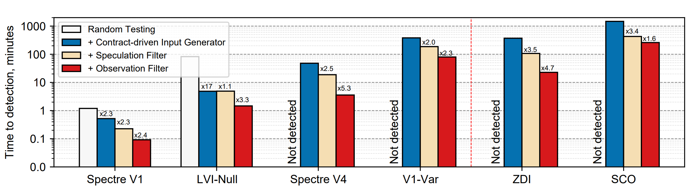
Results
Have not been reported before
Lower is better
Log Scale!
at least
x360 faster
at least
x18 faster
at least
x96 faster
at least
x10 faster
x13 faster
x24 faster
Notes:
Now let’s see what see ideas give us
We evaluate the effectiveness of our optimizations by how long it takes to detect different leaks.
Here, the Y axis shows the average detection time in a logarithmic scale
The X axis is different types of leaks
First we tried reproducing known leaks, as a baseline. Here, the left-most bar is without optimizations, and each bar one the right is one more optimization.
As you can see, the difference is very significant. We were able to detect all of these leaks within several hours when optimizations are enabled, while random testing did not detect them at all during our experiment – we had a timeout of 24 hours
Moreover, while doing our experiments we discovered two more leaks. It took mere hours to detect both of them with our optimizations.

Slide 13
Results
Have not been reported before
Lower is better
at least
x360 faster
at least
x18 faster
at least
x96 faster
at least
x10 faster
x13 faster
x24 faster

Slide 14
New Findings
String Ops Speculation
Finding:
String ops can speculate beyond their bounds
Div Operand Speculation
Finding:
64-bit divisions assume the upper bits of the dividend to be zero
Leak encapsulated in a single instruction!
An instance of value prediction!
  Both leaks were overlooked by previous research and testing tools!
Notes:
These new findings are caused by speculation on division and on string operations.
We found that 64-bit division speculatively assumes the upper bits of its operand to be zero,
and we found that string operands continue speculatively beyond the bounds of the intended strings.
Found in …

Slide 15
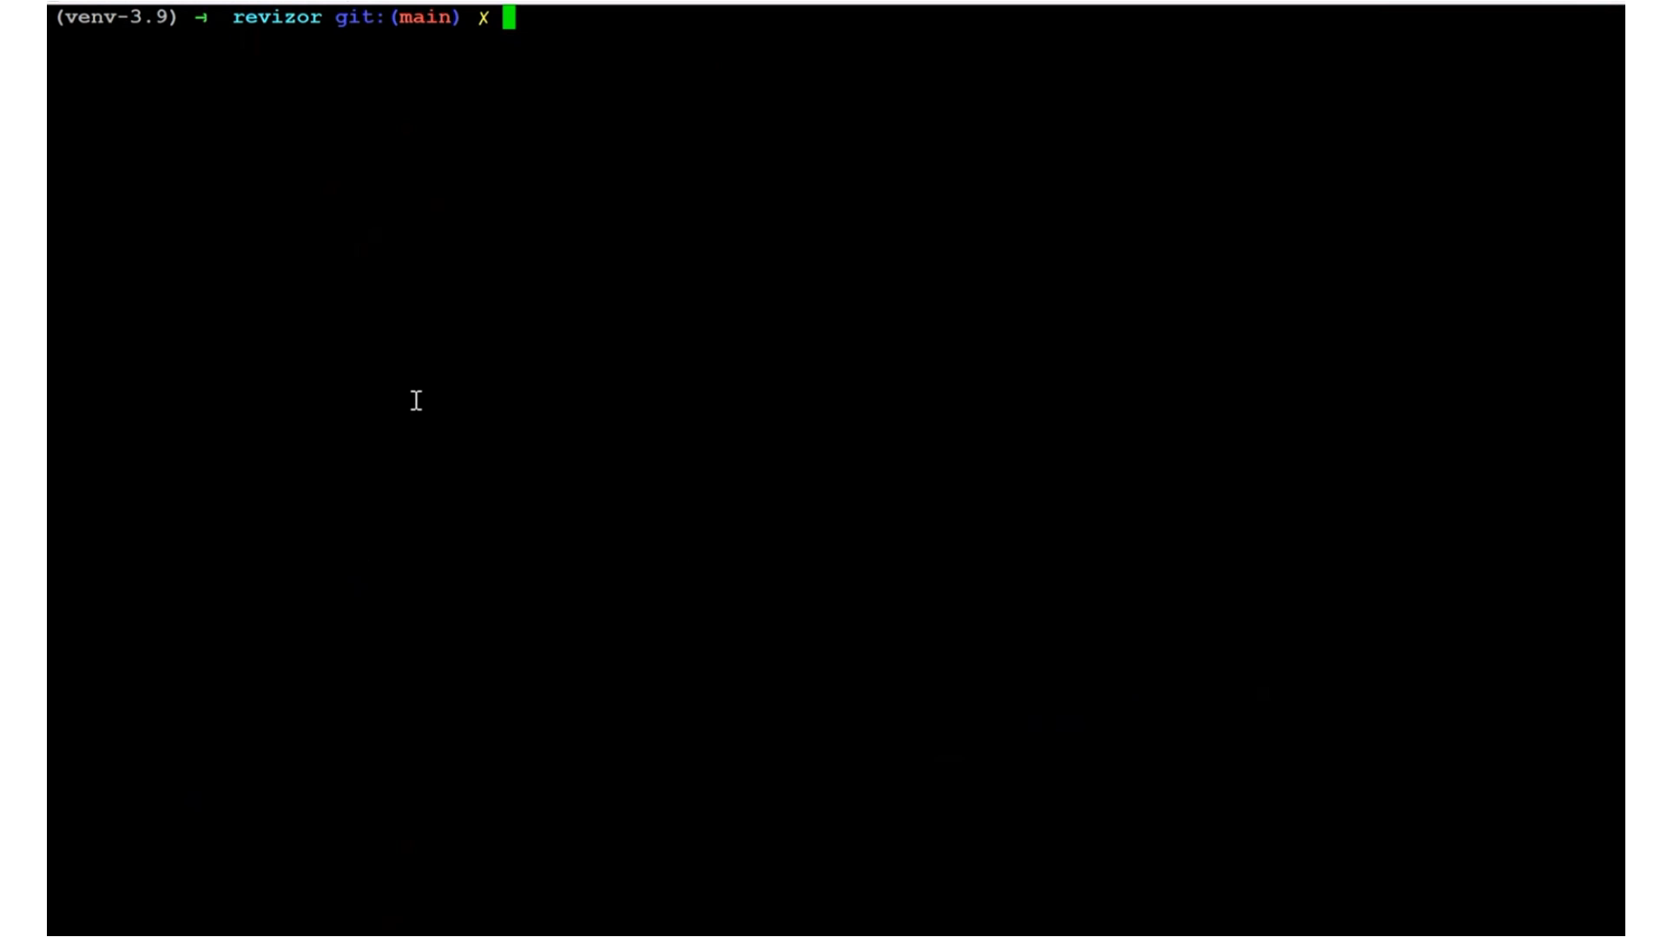
Demo
Notes:
Ok, so these are the results, but these plots do not give you an intuition of just how significant the speedup is. So I want to show you a demo
Here, we will be testing …

Slide 16





Hide & Seek with Spectres
Key Ideas:
speculative leaks can be detected faster if we don't waste time on non-speculative and non-leaky test cases
input effectiveness can be boosted via model-based taint tracking
Key Results:
detection time improved 10-50x
two new leaks discovered in already
  well-tested part of ISA
https://github.com/microsoft/sca-fuzzer
https://microsoft.github.io/sca-fuzzer/
Want an extended demo?
Or a quick tutorial?
Find me after the talk!
t-Oleksenkoo@microsoft.com @oleksii_o
Notes:
And that’s it from me. If you’re interested in trying this tool our, this is an open-source project, and it is actively maintainted. So if you want to give it a try – go ahead, you can find it on github, we have a webpage with some documentation, and if you have any questions – feel free to reach out.
Finally, I’m around on the conference today and tomorrow, so if you want an extended demo, a quick tutorial, or just want to chat about this topic – find me.

Slide 18
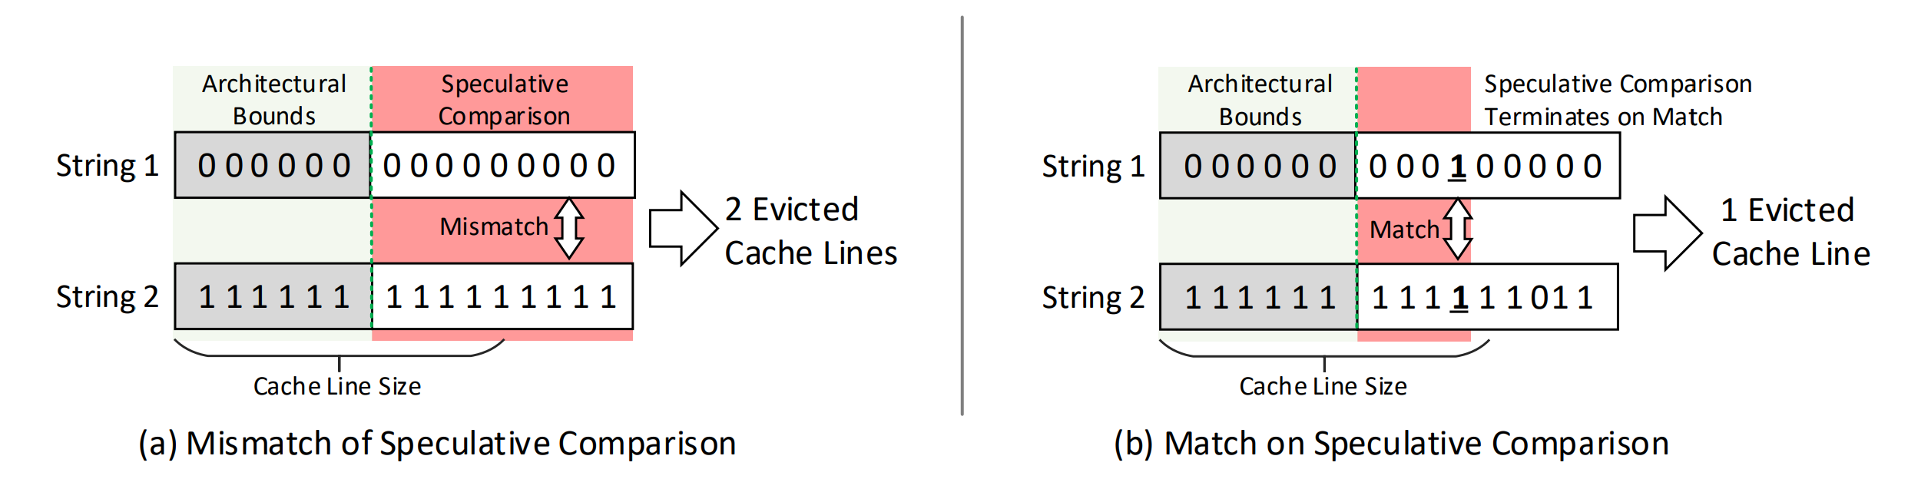
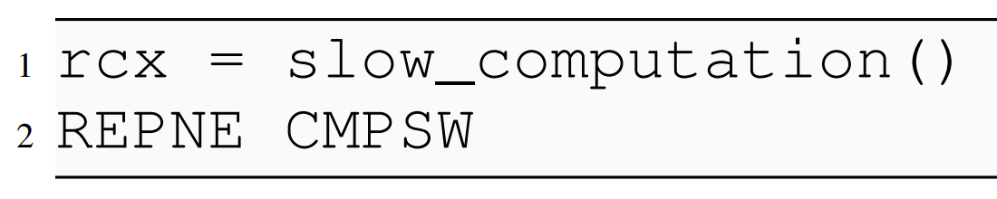
Speculative Comparison Overrun

Slide 19
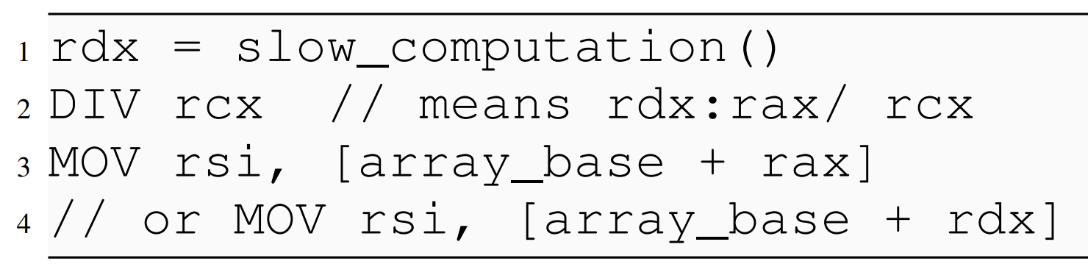
Zero Division Injection

Slide 20
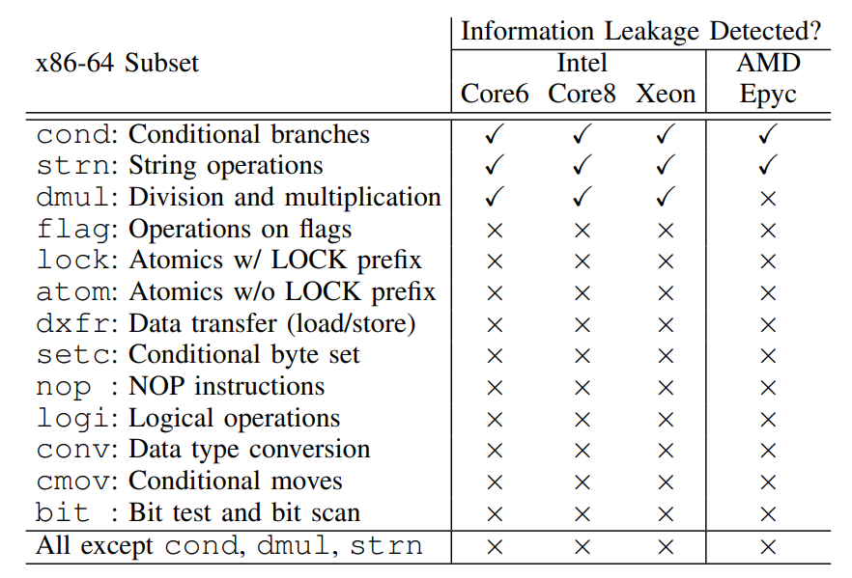

Slide 21
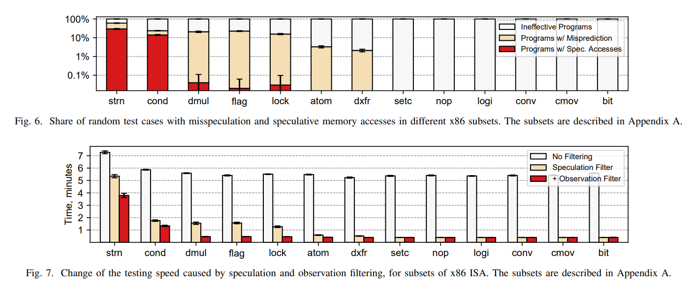

Slide 22
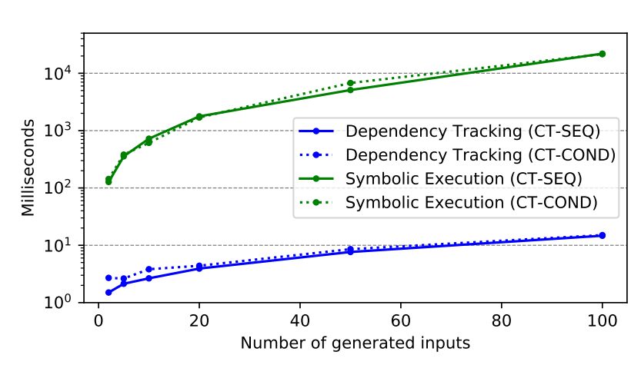

Slide 23
